Slide 1
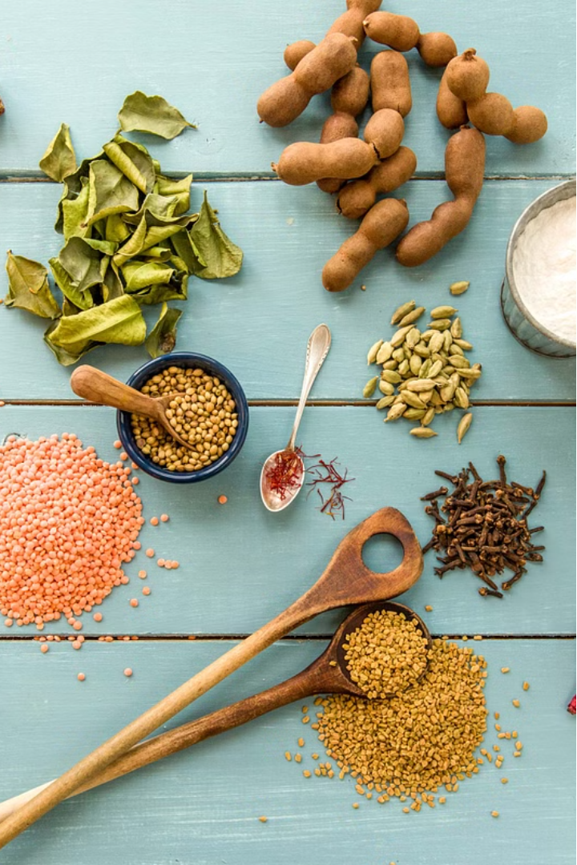



Building a Recipe Generator
This project focuses on developing a recipe generation system that can produce creative and practical cooking recipes based on given ingredients. The goal is to create a versatile tool that showcases students' ability to guide AI outputs.
by Claire Rebecca

Slide 2
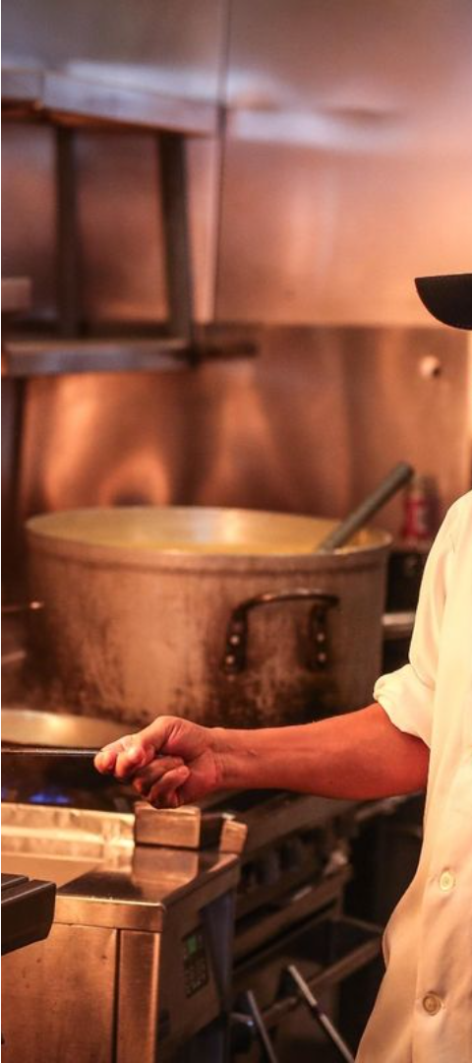
Defining the Objective
1
Ingredient-based Recipes
2
Creative and Practical Outputs
Generate cooking recipes using a set of provided ingredients as the input.
Ensure the generated recipes are both imaginative and suitable for real-world cooking.
3
Showcase Student Skills
Demonstrate students' ability to design effective prompts for desired AI-generated outputs.

Slide 3
Ingredient-based Recipe Generation
Ingredients as Input
Recipe Formulation
Diverse Outputs
The system should accept a list of ingredients as the primary input to generate recipes.
The AI model should use the provided ingredients to create a complete recipe, including instructions and proportions.
The generated recipes should cover a wide range of cuisines, dietary needs, and cooking methods.

Slide 4
Prompt Design Considerations
Specificity
Creativity
Craft prompts that provide clear guidelines and constraints for the desired recipe outputs.
Encourage the AI to explore innovative recipe ideas while maintaining practical feasibility.
Flexibility
Evaluation
Design prompts that can accommodate a variety of ingredient lists and dietary preferences.
Establish criteria to assess the quality and suitability of the generated recipes.

Slide 5

Evaluating Recipe Quality
1
Taste and Flavor
Assess the balance and appeal of the recipe's flavors.
2
Feasibility
Ensure the recipe can be realistically prepared with the given ingredients and instructions.
3
Nutritional Value
Evaluate the recipe's nutritional content and alignment with dietary requirements.

Slide 6




Iterating on Prompts
Prompt Refinement
Feedback Integration
Expanding Capabilities
Continuously refine and improve the prompts based on the quality of generated recipes.
Incorporate user feedback and real-world testing to enhance the prompts' effectiveness.
Explore ways to extend the system's abilities, such as handling dietary restrictions or unusual ingredients.

Slide 7




Showcasing Student Abilities
Recipe Generation
Creative Thinking
Evaluation Criteria
Iterative Improvement
Demonstrate the ability to create prompts that reliably generate diverse cooking recipes.
Showcase the students' creativity in designing prompts that encourage innovative recipe ideas.
Highlight the students' understanding of recipe quality factors and their ability to assess outputs.
Demonstrate the students' skills in refining prompts based on feedback and real-world testing.

Slide 8
Conclusion and Next Steps
Recap
This project showcases the development of a versatile recipe generation system that can produce creative and practical cooking recipes based on given ingredients.
Key Achievements
The system demonstrates the students' ability to design effective prompts, evaluate recipe quality, and iteratively improve the outputs.
Future Opportunities
Explore expanding the system's capabilities to handle more complex dietary needs, ingredient substitutions, and personalized recipe preferences.

